Slide 1
Linear Search Algorithm

Slide 2
Linear search is also called as sequential search algorithm. It is the simplest searching algorithm. In Linear search, we simply traverse the list completely and match each element of the list with the item whose location is to be found. If the match is found, then the location of the item is returned; otherwise, the algorithm returns NULL.

Slide 3
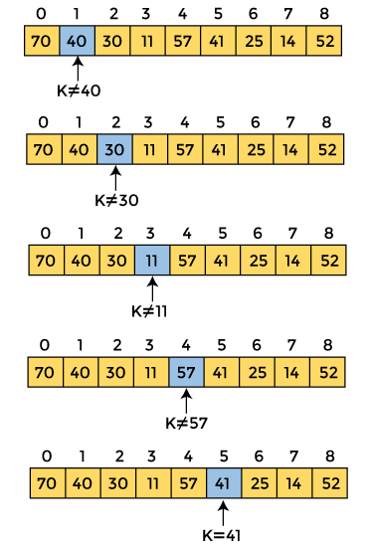

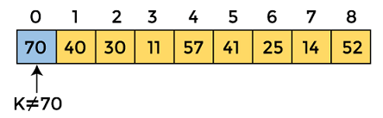
Working of Linear search
Let the element to be searched is K = 41

Slide 4
Linear Search complexity
Case | Complexity
Best case | O(1)
Average Case | O(n)
Worst Case | O(n)

